Slide 1
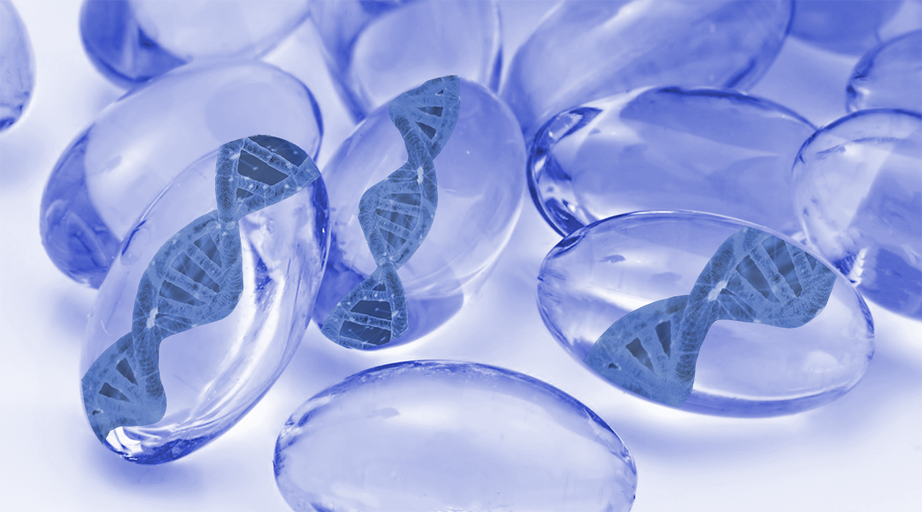
Smart Hydrogels
Andrea Cosimi
29, May 2019
Biomaterials and Tissue Engineering

Slide 2
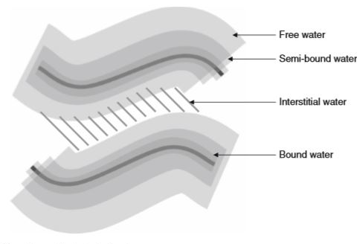
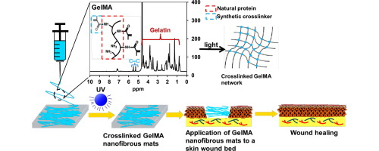
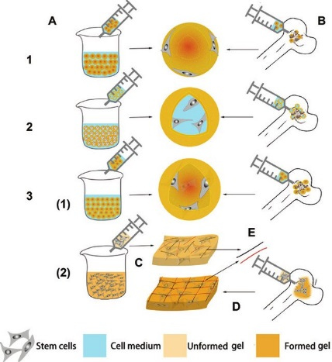
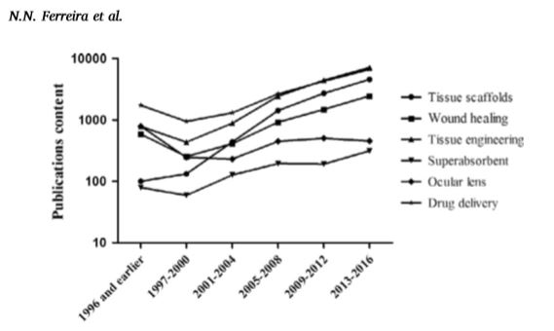
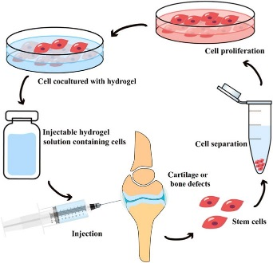
Smart Hydrogels – Introduction
Hydrogels
First studies related to hydrogels appeared in 1894
Number of publications showed exponential growth over the last ten years
Main applications:
Middle of the 20° century, they were termed as water-swollen crosslinked polymeric networks
Contact lenses
Super absorbent
Wound healing
Cell immobilization
Tissue scaffold
Notes:
In the late 19th century, hydrogels were first described as colloidal gels from inorganic salts.
Around the middle of the 20th century, Wichterle and Lim termed them as water-swollen crosslinked polymeric networks. Currently hydrogels can be defined as three-dimensional networks of hydrophilic polymers. These systems have the ability to swell and absorb large amounts of water and biological fluids without losing their structure. Their capacity to absorb liquids is due to the presence of hydrophilic compounds attached to the polymer chains, such as amid, amino, carboxyl and hydroxyl groups, which are able to ionize in the presence of water. Their physical properties, such as swelling degree, surface characteristics and mecanichal strength can be modulated by physicochemical reactions. In the picture, different kind of water in a hydrogel structure are shown.
The number of publications reported in the Science Direct Database involving hydrogels, containing such a keyword, has showed exponential growth over the last ten years as we can see in these diagrams.
The most common terms associated with hydrogels are
Super absorbent polymer: where in the picture is shown potassium polyacrylate
Contact lenses: Silicon hydrogel
Wound healing: Gelatin methacryloyl Photocrosslinkable hydrogel
Cell immobilization: where different type of immobilization are represented and

Slide 3
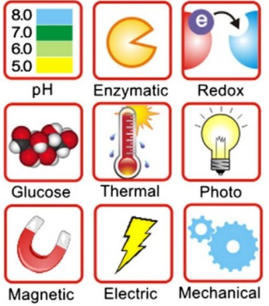
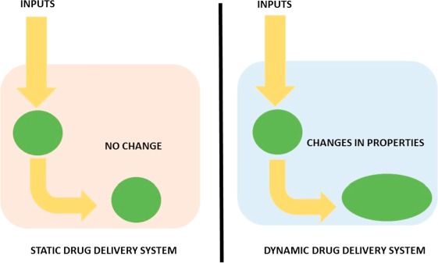
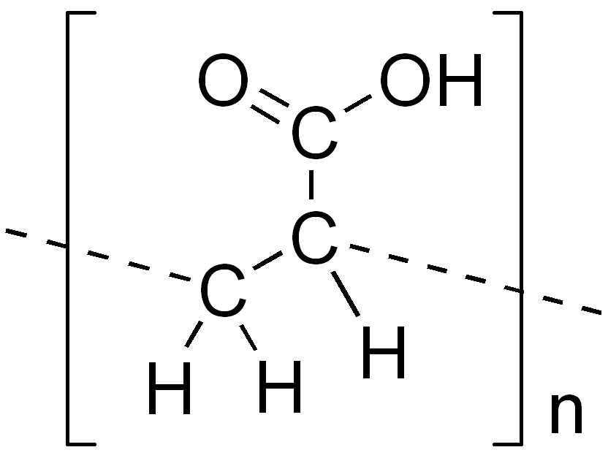
Smart Hydrogels – Introduction
Smart Hydrogels
The word «smart» was introduced in 1948 by Kuhn and co-workers
Delivery concept denominated as «smart» because it can detect prevailing stimuli and respond through structural, morphological or functional changes
Their unique properties can be
associated with environmental factors
The dynamic nature of supramolecular chemistry makes it applicable to the development of smart hydrogels
The final morphology expected for the hydrogel is associated with a series of variables, which primarily includes the synthesis or treatment procedures of the original polymer, monomer composition and their ratio
First publication about poly (acrylic acid), PAA, molecules that could undergo structural adjustments according with the media pH
Journal of Controlled Release 194 (2014) 1-19
Notes:
Although the first studies related to hydrogels appeared in 1894, the word smart was introduced in 1948 by Kuhn and co-workers. This most recent nomenclature gained importance because they are capable of exploitation based on specific triggers to induce changes in structure and function. Unlike conventional hydrogels, which exibit swelling/deswelling linked to water availability,
smart or stimuli-responsive hydrogels are the most promising materials because of their additional properties. These types of hydrogels are often related to the physical, chemical and biological fields and their unique properties can be associated with environmental factors such as external stimuli that promotes a change in organization.
Although a major focus has been on physical interactions (e.g. hydrophobic, hydrogen bonds and electrostatics), the dynamic nature of supramolecular chemistry makes it applicable to the development of such hydrogels. Smart hydrogels might self-assemble by establishing supramolecular interactions such as ionic bonds, weak physical entanglements and hydrogen bonds.
The conventional behavior of conventional hydrogels versus the dynamic behavior or smart hydrogels are two extremes of behavior that can significantly affect the performance of drug delivery system as we can see in the picture. The final morphology expected for the hydrogel is associated with a series of variables, which primarly includes the synthesis or treatment procedures of the original polymer, monomer composition and their ratios, and the crosslinking method.

Slide 4
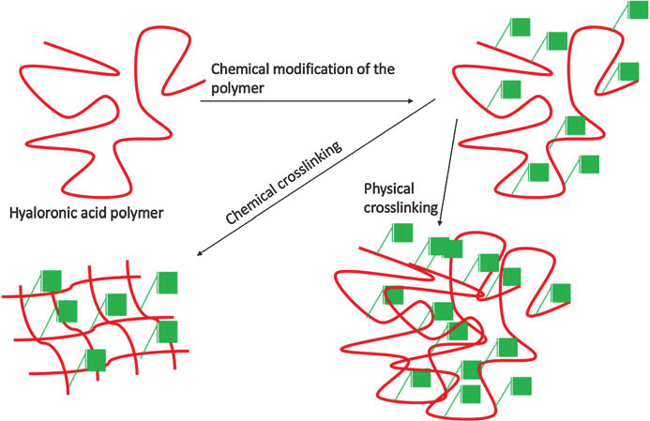
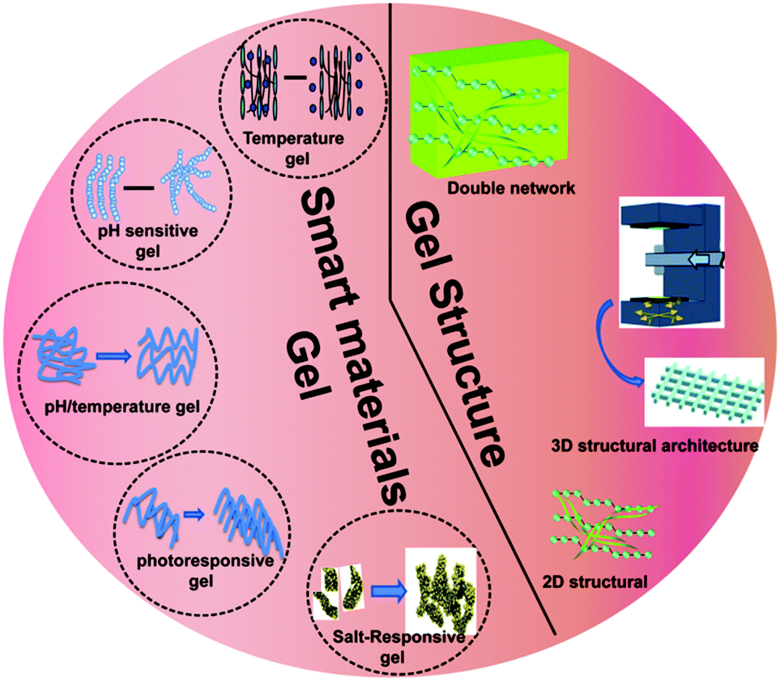
Smart Hydrogels – Classification
Smart Hydrogels
A set of criteria has been used to classify these systems, including origin (natural or synthetic), degradability and cross-linking mechanism.
By manipulating the factors involved in these links, we control the structural properties of the final system
Expected responses can be manifold and include degradation, drug release, swelling, changes in shape or surface, conformational modifications or micellization
Responsiveness
Notes:
A set of criteria has been used to classify them, including origin (natural or synthetic), degradability and cross-linking mechanism for self-assembly. Chemically cross-linked hydrogel networks are generated by covalent bonds between polymer chains resulting in permanent junctions. On the other hand, physically cross-linked structures are designed through supramolecular forces (non covalent) forming rapid and reversible networks, a feature that we are particularly interested in.
Upon receiving these external inputs, the systems undergo a structural/morphological property change, which leads to the desired outcomes. This off-on transition is ultimately responsible for achieving the biological function. Expected responses can be manifold and include degradation, drug release, swelling, changing in shape and surface, conformational modification or micellization.
Image: Publications focused on drug delivery have primarily considered external type of stimuli. Responses can be induced by physical or chemical stimuli. The first type includes: pressure, light, temperature and magnetic or electric fields. Chemical or biochemical stimuli include ionic strength, pH and ions. Moreover, these systems can be designed to respond a multiple stimuli listed above.

Slide 5
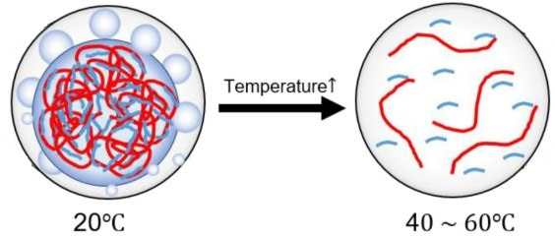
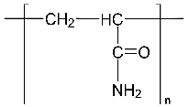
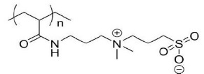
Smart Hydrogels – Thermo-responsive
As medium temperature may fluctuate in physiological and pathological conditions, thermo-responsive hydrogels are one of the most studied classes of stimuli systems in tissue engineering and drug delivery research
Thermo-responsive hydrogels can be divided into two groups: lower critical solution temperature (LCST) and upper critical solution temperature (UCST)
From 2005 to 2010, only 44 publications per year were addressed to UCST against 330 included LCST
Several polymers can be included in both LCST and UCST classes, e.g. PEO, which shows a loop-shaped miscibility gap with UCST > LCST.
PAAs PAMs Sulfonate
Phase transition phenomenon. (a) LCST and (b) UCST phase transition behaviors of thermo-responsive polymers in solution
Notes:
Thermo-responsive hydrogels are one of the most studied classes of stimuli systems in tissue engineering and drug delivery research, as medium temperature may fluctuate in physiological and pathological conditions. These hydrogels, composed mainly of natural and synthetic polymers with balanced hydrophilic and hydrophobic groups. They also swell or de-swell in response to a critical temperature, which causes a sudden change in the solvation of their molecules, conformational state and, consequently, water-solubility.
Thermo-responsive hydrogels can be divided in two groups according to their behavior with the surrounding solvent molecules. Extensively studied, lower critical solution temperature LCST hydrogels exhibit non-linear responses, where the polymer’s solubility decreases as the temperature increases, leading to a formation of a more structured gel. The second type, upper critical solution temperature UCST systems, on the other hand, became soluble upon heating.
From 2005 to 2010, 330 publications per year included LCST, while only 44 included UCST. The main reason for this disparity is based on the fact that most of the UCST polymers have a transition temperature below 25°, which makes them infeasible for pharmaceutical and medical product development. Moreover, the biodegradability of these polymer class has not yet been proven. The UCST group is composed of acrylamide AAm, and acrylic acid (AAc) derivatives, such as PAAs, PAMs, sulfonates and zwitterionic polymers. Their use as UCST is dependent on their concentration in solution and ranges from 32° at 0.1% (w/v) to 15° at 8% (m/v
Several polymers… The temperature transition of PEO is influenced by ionic strength and chemical crosslinking by radiation. PEO is not biodegradable, thus its toxicity is a concerning point.
Critical temperature is usually determined by ultraviolet spectroscopy and differential scanning calorimetry techniques as well as transmittance, viscosimetric, Dynamic Light Scattering (DLS) and pH measurements.

Slide 6
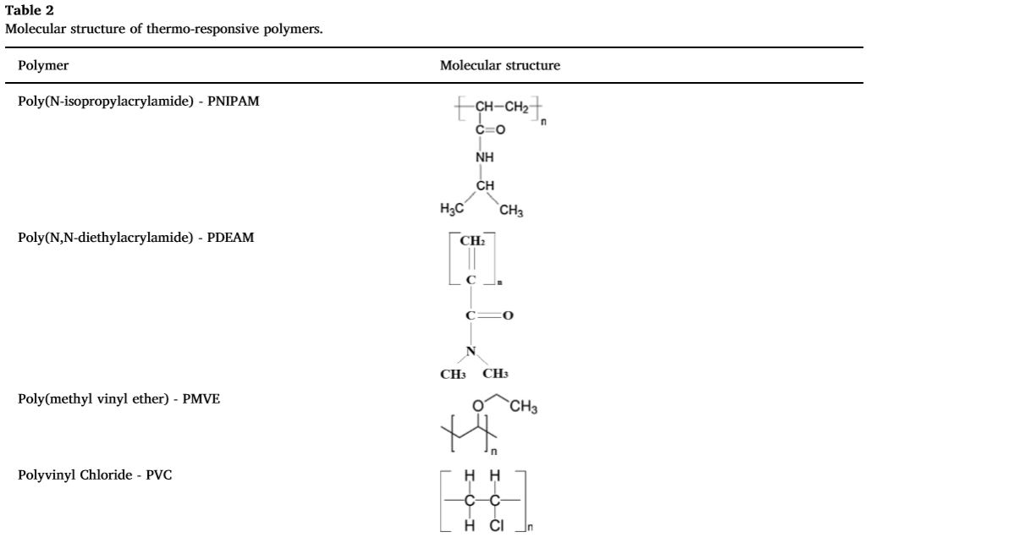
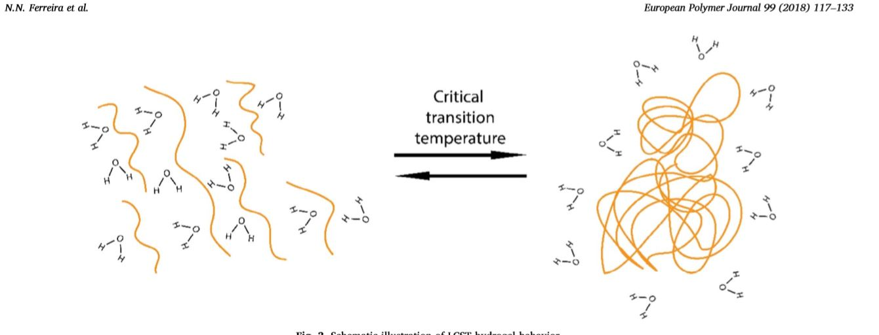
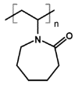
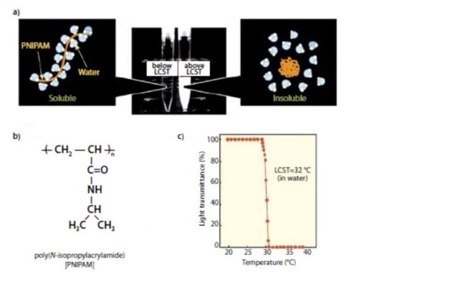
Smart Hydrogels – Thermo-responsive
For LCST hydrogels, at lower T°, water molecules are arranged around the polymer. The increase of environmental T° reduces the energy associated to the water-polymer interaction. Thus, the polymer dehydrates, transforming itself into a more hydrophobic structure and causing phase separation
Stimuli-responsive behaviour of PNIPAAm. Source: Material Matters 2010, 5.3, 56
Notes:
For the LCST hydrogels, at lower temperatures, the water molecules are arranged around the polymer, establishing hydrogen bonds with the hydrophilic groups of the structure, resulting in a small change in entalphy and, low entropy. However, the increase of environmental temperature reduces the energy associated to the water-polymer interactions, allowing an increase in the energy associated to the polymer-polymer interactions. The change in enthalpy increases. To maintain the change in Gibbs free energy low and to compensate this increase in entalphy term DH, water molecules dissociate from the polymer and the entropy increases (spontaneous process). Thus, the polymer dehydrates, transforming itself into a more hydrophobic structure and lastly causing phase separation. The values of the critical temperature point usually depends on the molecular weight, which is lower for longer polymer chains or for hydrogen-bonding capabilities of constituent monomer units. Critical temperature is usually determined by ultraviolet spectroscopy and differential scanning calorimetry techniques as well as transmittance, viscosimetric, Dynamic Light Scattering (DLS) and pH measurements.
Image: PNIPAM and PDEAM have similar transition temperatures and are the most commonly used polymers in thermo-responsive hydrogels development. For PMVE, the LCST is influenced by polymer tacticity, i.e. the regularity in the arrangement of side groups. On the other hand, for PNIPAM, the transition temperature can be influenced by molecular design with changes in the hydrophilic/hydrophobic balance which is independent of the polymer concentration and molecular weight. The PNIPAM response against increases in temperature from 32° to 25° generates a particular interest in drug delivery design, especially due to its biocompatibility compared with PDEAM. Use of PNIPAMs is anyway limited due to the cytotoxicity attributed to the presence of a quaternary ammonium in its structure, its non-biodegradability and its ability to activate platelets upon contact with body fluids promoting coagulation. PMVE is a water soluble LCST polymer which displays temperature transition at exactly 37°, making it very interesting for pharmaceutical and biomedical applications. These systems exhibit a discontinuous temperature dependent swelling behavior, in which concentration might represent a limitation in the system.
PVC, in the picture showed as polyvinylchloride, is I suppose poly(N-vinylcaprolactam), has interesting properties to be used in medical devices and implant development, such as water solubility, biocompatibility, high swelling, transition temperature at 33° and low cost.
The picture shows the stimuli responsive behavior of PNIPAAm. It is soluble in organic solvents, such as chloroform and acetone, as well as cold water. Heating an aqueous PNIPAAm solution past 32 °C instantly coverts the clear solution into a milky suspension as shown in the graph. PNIPAAm remains the leader for biomedical applications because of the sharpness of the transition

Slide 7
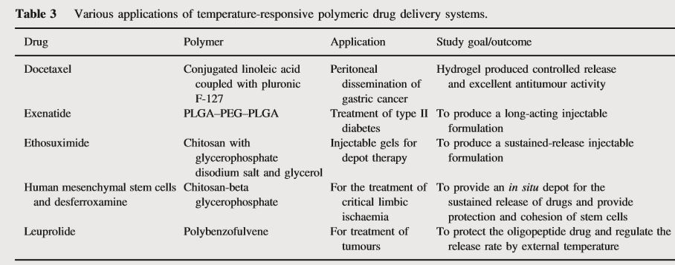
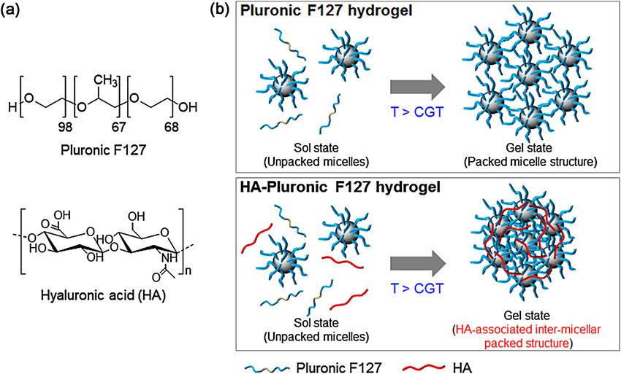
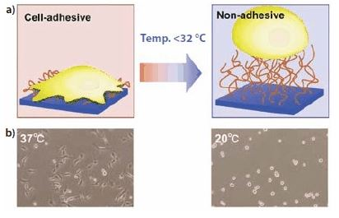
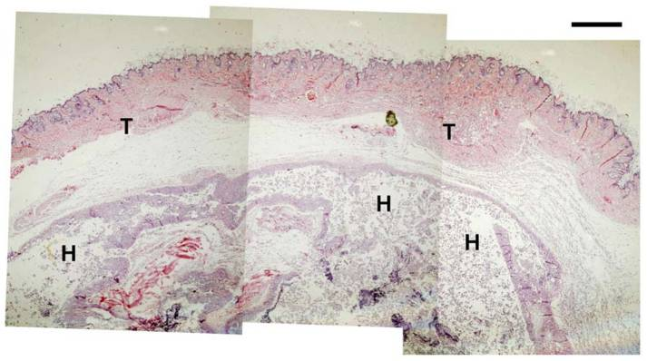
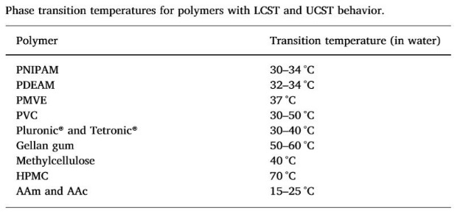
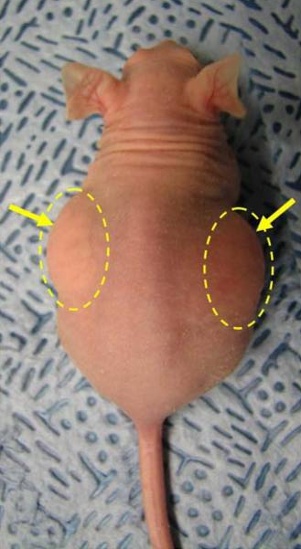
Smart Hydrogels – Thermo-responsive
PNIPAAm for use as a smart culture surface
Source: Material Matters 2010, 5.3, 56
Thermosensitive injectable PNIPAAm-hyaluronic acid copolymer hydrogel for adipose tissue engineering
Notes:
Copolymer blocks of poly(ethylene oxide) and poly(propylene oxide) sequences are a class of polymers marketed as Pluronics and Tetronics. These polymers exhibit a transition behavior when temperatures are close to the physiological temperature and they are extensively used as drug delivery systems and injectable devices for tissue engineering processes.
Pluronics and Tetronics have an amphiphilic character, meaning it has a polar, water-soluble group attached to a nonpolar water-insoluble hydrocarbon chain and gelation occurs by a 3D packing of the polymer molecules in micells due to the hydrophilic-hydrophobic balance. The transition temperatures for these compounds are dependent on their concentration and can be modulated by incorporating different side chains with hydrophilic or hydrophobic segments. These synthetic polymers are very useful, but one of their limitation is their non-biodegradability.
Gelan Gum is a hydrophilic and anionic exopolysaccharide composed of repeated units of glucose, glucuronic acid, rhamnose (at a 2:1:1 molecular ratio) and two acetyl substituents, acetate and glycerate, which are linked to glucose residue adjacent to the glucuronic acid. GG is biocompatible, biodegradable and can originate hydrogels at low concentrations. Upon heating, these polymers adopt a random coil conformation. Then, when temperature decreases, the chains adopt a double-helical conformation with ordered junction zones, resulting in a 3D network. These characteristics make GG a suitable material for pharmaceutical applications. Despite presenting higher transition temperatures, some natural polymers such as cellulose derivstives, chitosan and gelan gum, hold a good biodegradability and can be used to develop thermo-responsive hydrogels. After water dispersion and heating, most of these natural polymers form a gel phase when the temperature is lowered. Cellulose derivatives such as Methylcellulose and hydroxypropyl methylcellulose are soluble in water at low temperatures but after heating at 40° and 70° respectively, they form opaque gels. For physiological applications, these transition temperatures are not applicable, but some strategies can be applied to decrease the LCST. Incorporating NaCl decreases the methylcellulose transition temperature to 32-34°.
Chitosan a chitin deacetylated derivative, is a natural cationic biocompatible biodegradable and low-cost polymer which is obtained by treating the chitin shell of shrimps with an alkaline substance such as sodium hydroxide. It is composed of randomly distributed d-glucosamine and N-acetyl-glucosamine linked by beta (1-4) glycosidic bonds. It is soluble in solvents whit pH below 6, and because of this, the gelation of CH solution is pH dependent. However, Chitosan polymer dispersion can become thermo-responsive by adding a polyol (A polyol is an organic compound containing multiple hydroxyl groups) salt in the solution. In this case, at body temperature, CH chains lose their hydrating water and the polyol salt facilitates the interaction between side groups, such as hydrogen bonding, electrostatic interactions and hydrophobic interactions. Thus, CH hydrogels have become promising tools for the cartilage repair.
Applications
In 2009, they developed a thermosensitive injectable hyaluronic acid hydrogel for adipose tissue engineering. In the pictures we can see the subcutaneous injection AHA-g-PNIPAAm-53 copolymer hydrogels implants in nude mice after 2h. Yellow arrows denote hydrogel bumps after injection. The second picture shows H & E staining (which is is one of the principal stains in histology) of AHA-g-PNIPAAm-53 copolymer hydrogels after 5d of implantation. T: tissue; H: hydrogel.

Slide 8
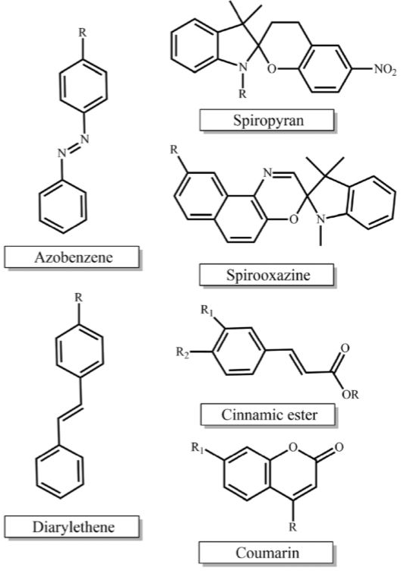
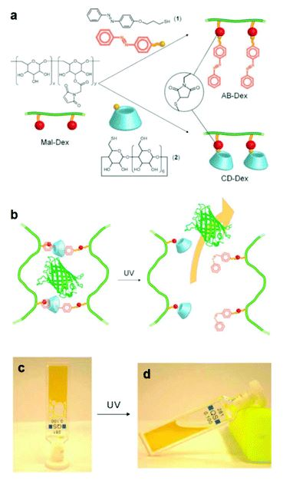
Smart Hydrogels – Light-responsive
Smart Hydrogels – Light-, electric- and magnetic- responsive
Electric, magnetic fields, and light exposure are the main external physical stimuli used to tune drug release kinetics from smart hydrogels. Once this stimuli can be controlled, they have the advantage of modulating drug release spatially and temporally.
Photo-sensitive polymers can change their physicochemical properties or degrade in response to light irradiation of appropriate wavelength and intensity.
Two types of UV light response: photopolymerization and photocleavage systems
Photopolymerization:
Chemical structure of light-responsive moieties employed in the synthesis of photo-responsive polymers.
K. Peng , I. Tomatsu and A. Kros , Chem. Commun., 2010, 46 , 4094 -4096
Notes:
Electric, magnetic fields and light exposure are the main external physical stimuli used to tune drug release kinetics from smart hydrogels. Once this stimuli can be controlled, they have the advantage of modulating drug release spatially and temporally.
Photo-sensitive polymers can change their physicochemical properties or degrade in response to light irradiation of appropriate wavelength and intensity. Light is a readily available trigger and is often inexpensive, i.e. lamps. The stimulus source used can be derived from visible, near infrared (NIR) or ultraviolet (UV) light. There are two types of UV light responsitivity: photopolymerization and photocleavage systems.
Photopolymerization consist of a gelation process of a liquid polymeric formulation to obtain a hydrogel system. Although it has been used as one stage in hydrogel synthesis, photopolymerization can also be used to induce in situ gelation. In order to occur photopolymerization, photoinitiators as shown in the image must interact with visible or UV light to form free radicals. Another approach is the functionalization of hydrophilic polymers with photosensitive moieties, such as cinnamate or coumarin which are able to undergo intramolecular photodimerization after UV light exposure.
In the picture, gel–sol transition and the release of the green fluorescent protein is shown in b) and in c) the supramolecular gel obtained upon mixing the two dextran polymers and (d) the sample after irradiation with UV light.

Slide 9
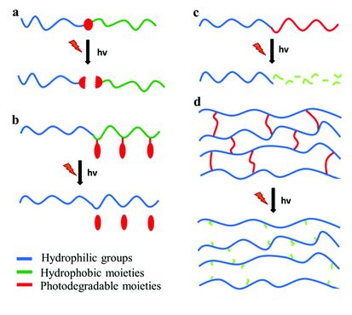
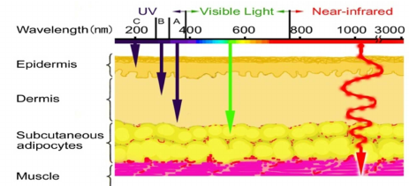
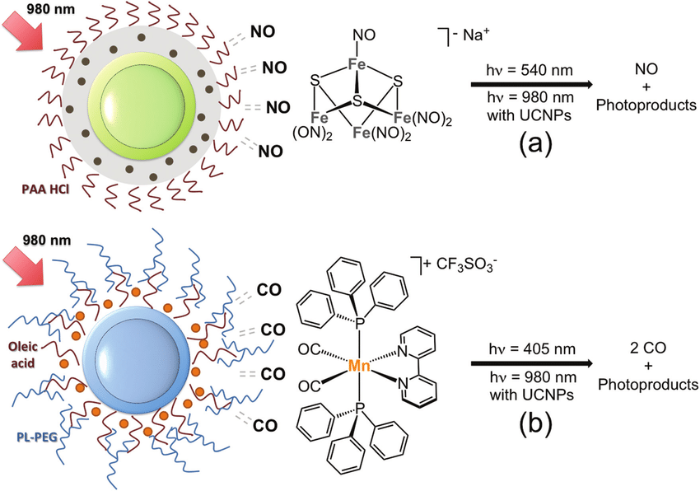
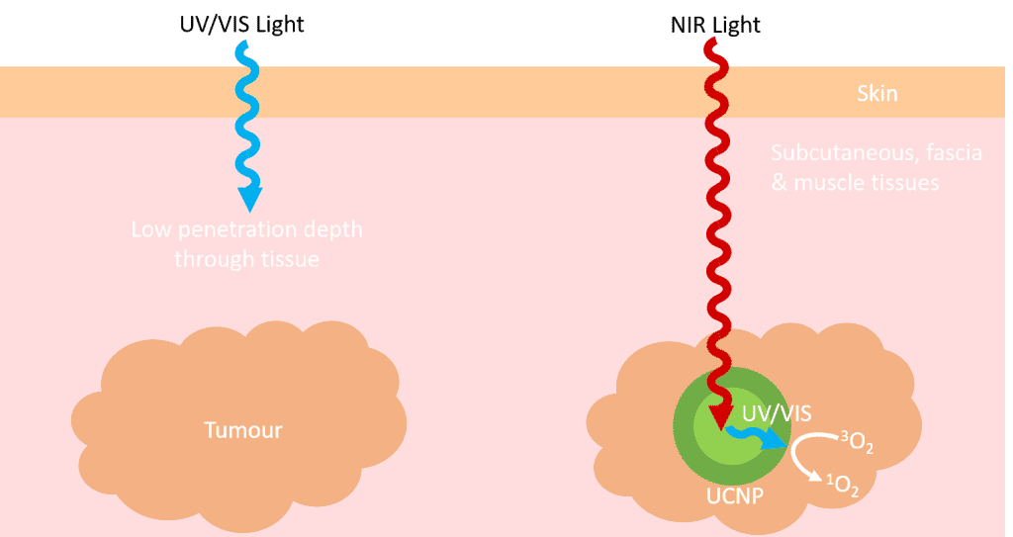
Smart Hydrogels – Light-responsive
Photocleavage:
Disadvantages in using UV light
low penetration
potentially carcinogenic
A valid alternative is the use of UCNPs, which are able to convert photon energy absorbed from NIR light into UV light
Photodegradable polymeric materials containing (a) a photolabile junction, (b) photo-labile pendant groups, (c) photodegradable backbone and (d) photo-labile cross-linkers
Notes:
The main principle of photocleavage for light-responsive polymers is based on the use of cross-linkers that exhibit photosensitivity. These molecules, after exposure to light, undergo either photoisomerization or photooxidation, which lead to changes in hydrogel matrix structure and, consequently, in drug or biomolecule release. However, some differences in the absorbance and quantum yield of this photosensitive crosslinking agents at different wavelengths, result in different degradation rates. Therefore, the choice of wavelength can be very important to control the release of drug from this responsive systems.
It is important to note that UV light holds some disadvantages when used as a physical stimulus for smart hydrogel drug delivery. UV has a poor penetration into some body parts, and it can be potentially carcinogenic especially under long-term exposure.
One of the strategies used to overcome these problems is adopting smart hydrogels containing up-converting nanoparticles (UCNPs) as the UV light source. This is an alternative because UCNPs are able to convert photon energy absorbed from NIR light into UV light. Thus, the cross-linked photosensitive molecules absorb the UV light to initiate the sol-gel process, triggering the release of the drug. An important parameter to be considered abput these systems is the distribution of photocleavable cross-linkers molecules and UCNPs.
UCNPs are a unique class of optical nanomaterial doped with lanthanides ions featuring electronic transitions within the 4f electron shells. These nanoparticles can up-convert two or more lower energy photons into one higher-energy photon

Slide 10
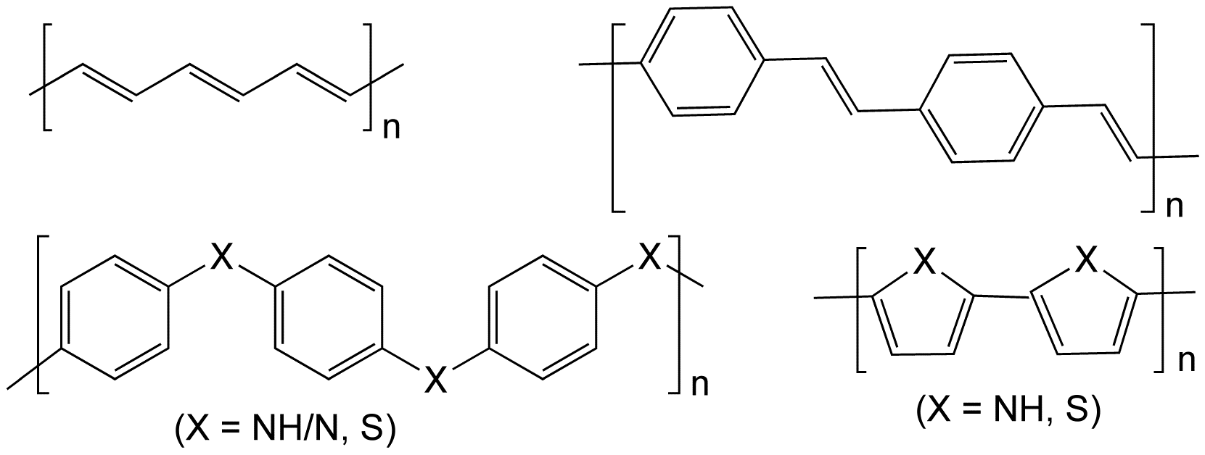
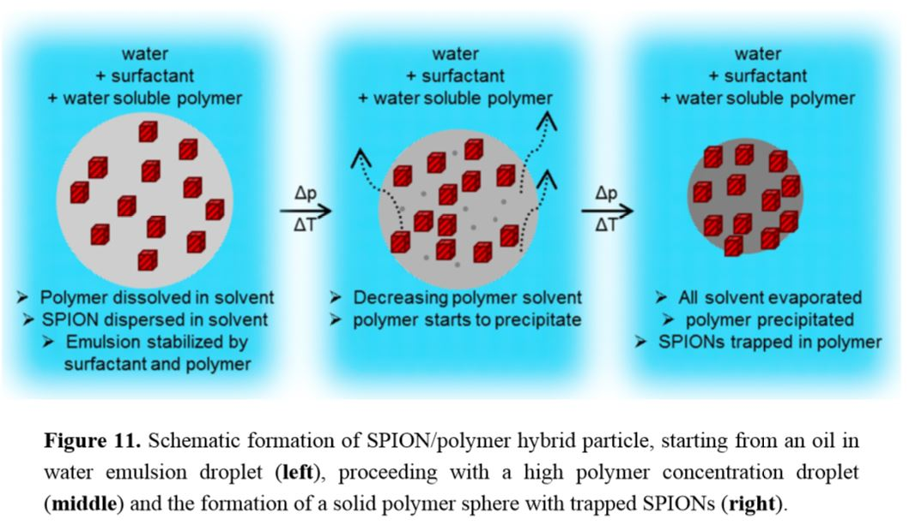
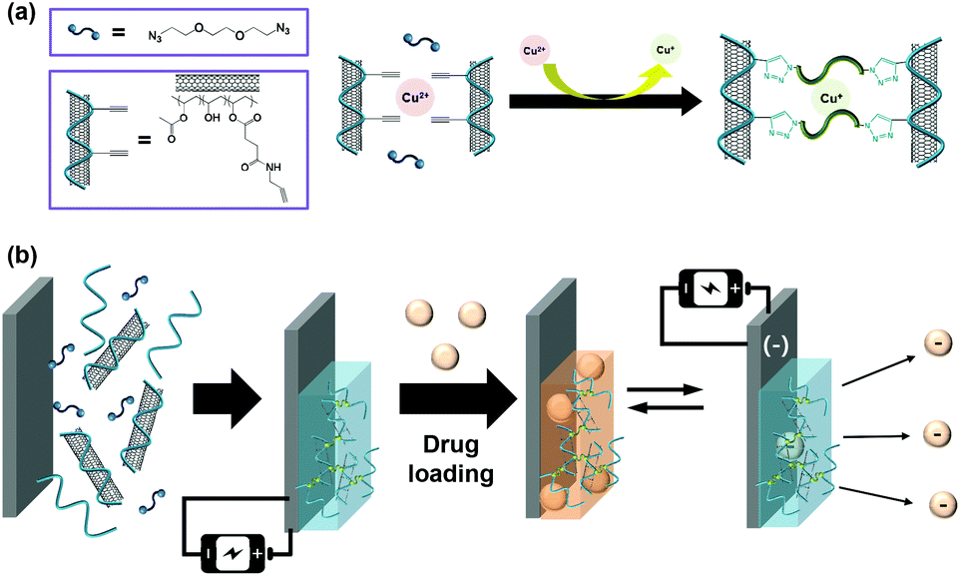
Smart Hydrogels – Electric-responsive
Smart Hydrogels – Electric- and Magnetic-responsive
Electro-responsive systems are materials that respond to an applied electric field by changing their size or shape. They are termed as electro-conductive hydrogels (ECHs), developed from polyelectrolytes or from ICPs.
The development of magnetic nanomaterials has been the source for the discovery of spectacular new phenomena, with potential applications in numerous fields
HFMFs are less invasive than electric fields or light exposure
Magnetic hydrogels developed by inclusion of MIONs in the polymer matrices. MIONs/polymer ratio determines the saturation magnetization and consequently the drug release performance
Chemical structures of some conductive polymers. From top left clockwise: polyacetylene; polyphenylene vinylene ; polypyrrole (X = NH) and polythiophene (X = S); and polypyrrole (X = NH) and polyphenylene sulfide (X = S).
Notes:
Elextric fields are also used as external stimuli to modulate drug release from smart hydrogels. These systems, are developed either from polyelectrolytes or from an intrinsically conductive polymer (ICP) within a 3D cross-linked polymer network. When an electric field is applied, driven charges are moved. Thus, ICPs can undergo electrochemical oxidation/reduction, leading to structural changes in the hydrogel and subsequently polymeric network erosion to release the incorporated drug.
Drug release from a ECH hydrogel can be related to drug charge as shown in a study in 2015. In this study, tetracycline was incorporated into a carbon nanotube with a polyvinyl alchol PVA-based hydrogel- At pH=8, tetracycline becomes negatively charged and therefore faster release was observed when a negative electric current was applied. This effect is due to the repulsion between drug and the negative bias (environment). However, when a positive electric current was applied the release was slower.
SEM images of CNT-embedded hydrogel films after lyophilisation showed porous structures.
Several publications have reported high-frequency magnetic fields (HFMFs) as external stimuli for drug delivery; a strategy which aims to accumulate these systems in an effected area.
HFMFs are less invasive than electric fields or light exposure because they are ablo to highly permeate tissues with a low energy absorption. Magnetically responsive hydrogels are developed by incorporating magnetic iron oxide nanoparticles (MIONs) into the polymer matrices. They are widely explored, especially in association with thermo-responsive hydrogels. The use of MIONs is based on their capacity to transform electromagnetic energy, from an external high-frequency field, into heat. MIONs/polymer ratio determines the saturation magnetization and consequently the drug release performance. Schematic formation of SPION/polymer hybrid particle, starting from an oil in water emulsion droplets, proceeding with a high polymer concentration droplet and the formation of a solid polymer sphere with trapped SPIONS

Slide 11
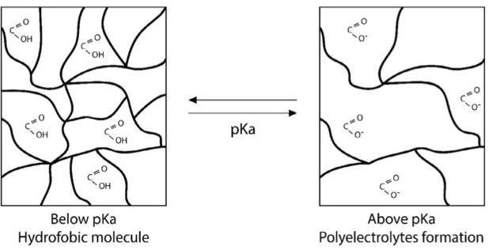
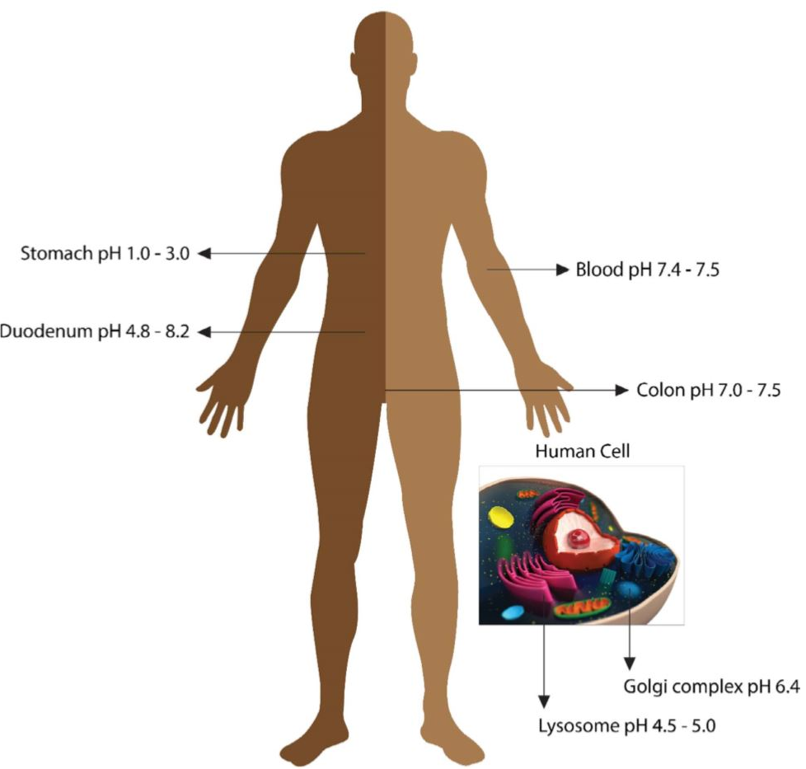
Smart Hydrogels – pH-responsive
The human body exhibits subustantial pH changes in different body parts when functioning normally. Additionally, some diseases can also cause pH changes in the human body
Similar to macromolecules, a polymer network contains ionizable groups that can donate or accept protons in response to pH. In aqueous solutions they are polyelectrolytes
Two classes of pH responsive hydrogels
pH values in several healthy tissues and cell compartments
Notes:
The human body exhibits subustantial pH changes in different body parts when functioning normally. Additionally, some diseases can also cause pH changes in the human body. The pH spectrum among different sites represent attractive targets for biomedical fields by which pH responsive hydrogels could respond to a dynamic environment. Moreover, pH changes might be easily manipulated and are applicable for in vitro and in vivo conditions.
Chemical stimuli, such as pH change, directly affect the interactions between polymer chains and between polymer chains and solvent molecules. Similar to macromolecules, such as protein and nucleic acids, a polymer network contains ionizable groups that can donate or accept protons in response to pH, which primarly results in solubility and structural changes and, consequently, swelling or deswelling.
Bronsted acids and bases are mostly used as respective pendants since their protonation/deprotonation occur at pH values between 4.0 and 8.0. Charged polymers in aqueous solution are polyelectrolytes, which might adopt expanded conformation as a result of electrostatic repulsion, enabling the hydration process. The transition point is governed by the pKa value, and when the pH of the medium approaches the pKa, the ionization degree of the polymer suffers a dramatic change. The cross-linking process between responsive polymeric chains results in the self-assembly of smart hydrogels, changing its hydrodynamic volume according to the pH value. The swelling of polyelectrolytes occurs most often as a result of electrostatic repulsion between charges on the polymer backbone, which is directly related to pH alterations. Charge exposition in aqueous medium is guided by the presence of carboxylic and amine groups that designate anionic and cationic behavior. The critical pH value that determines their responsiveness can be modified by the incorporation of hydrophobic moieties, generally by copolymerization with hydrophobic monomers.

Slide 12
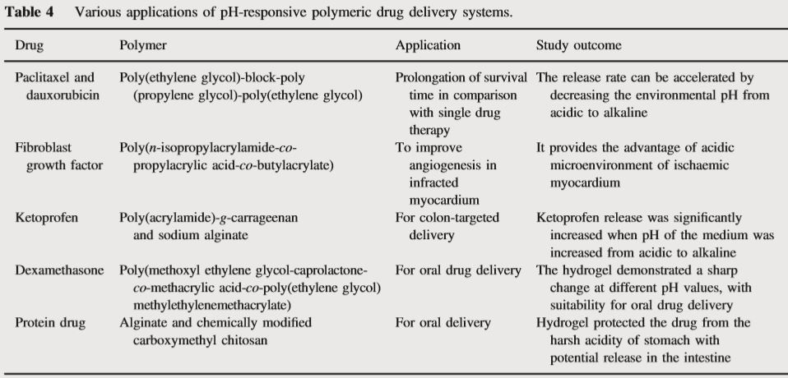
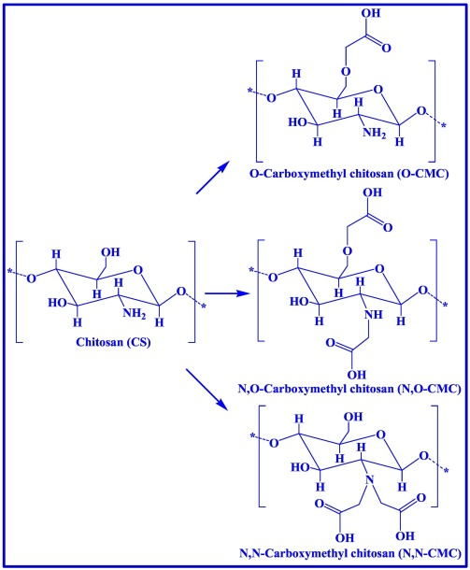
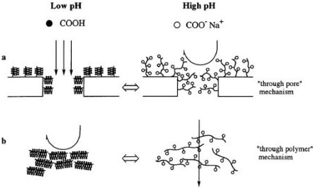
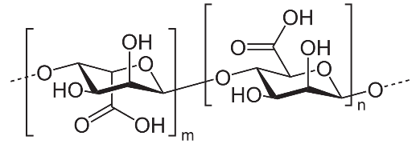
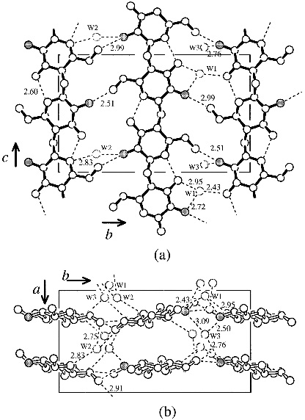
Smart Hydrogels – pH-responsive
pH-responsive behavior can also be found among natural polymers such as alginate, albumin, chitosan, pectin and gelatin
Chitosan and alginate are representative natural polyacid and polybasepolysaccharides, that suffer physical cross-linking through hydrophobic or charge interactions
Alginate
Chitosan
Explanation of pH-dependent water permeation through (a) a porous membrane and (b) a dense membrane
Crystal structure of Chitosan
Notes:
In the table 4, the main of pH responsive hydrogels are shown, taken from articles in the references.
In the second picture, what we see is a device used in the oil-gas industry as viscosification agents.
PH responsive behavior can also be found among natural polymers such as alginate, albumin, chitosan and gelatin. When comparing synthetic homologous to natural patterns, it is necessary to highlight the high capacity of naturale polymers to degrade in the body.
IMAGE
Chitosan and alginate are representative natural polybase and polyacid polysaccharides, respectively, that suffer physical cross-linking through hydrophobic or charge interactions . Swelling or liquid expulsion occurs based on the availability or ionized group along the polymer chain. For Chitosan, the protonation of amino groups under low pH promotes electrostatic repulsion between cationic segments.
Due to its rigid crystalline structure, Chitosan exhibits low solubility in water and biological fluids, where the pH is 7.4, which might limit its use in hydrogel development. However, a variety of chitosan copolymers can overcome this limitation. Given its excellent biocompatibility and biological properties, carboxymethyl chitosan demonstrated good solubility in a wide range of pH. This was due to the additional presence of COOH groups which also govern the swelling behavior. Thus, CM-CS have great potential as an oral drug delivery system that allows drugs to reach the colon.
The use of copolymers consisting of methacrylic acid (MAA) and grafted poly(ethylene glycole) PEG chains was explored to develop an oral platform for therapeutic proteins. Biodegradable and pH sensitive hydrogels composed of polyacrylic acids (PAAD) showed interesting properties for their use as insulin drug delivery by oral administration.

Slide 13
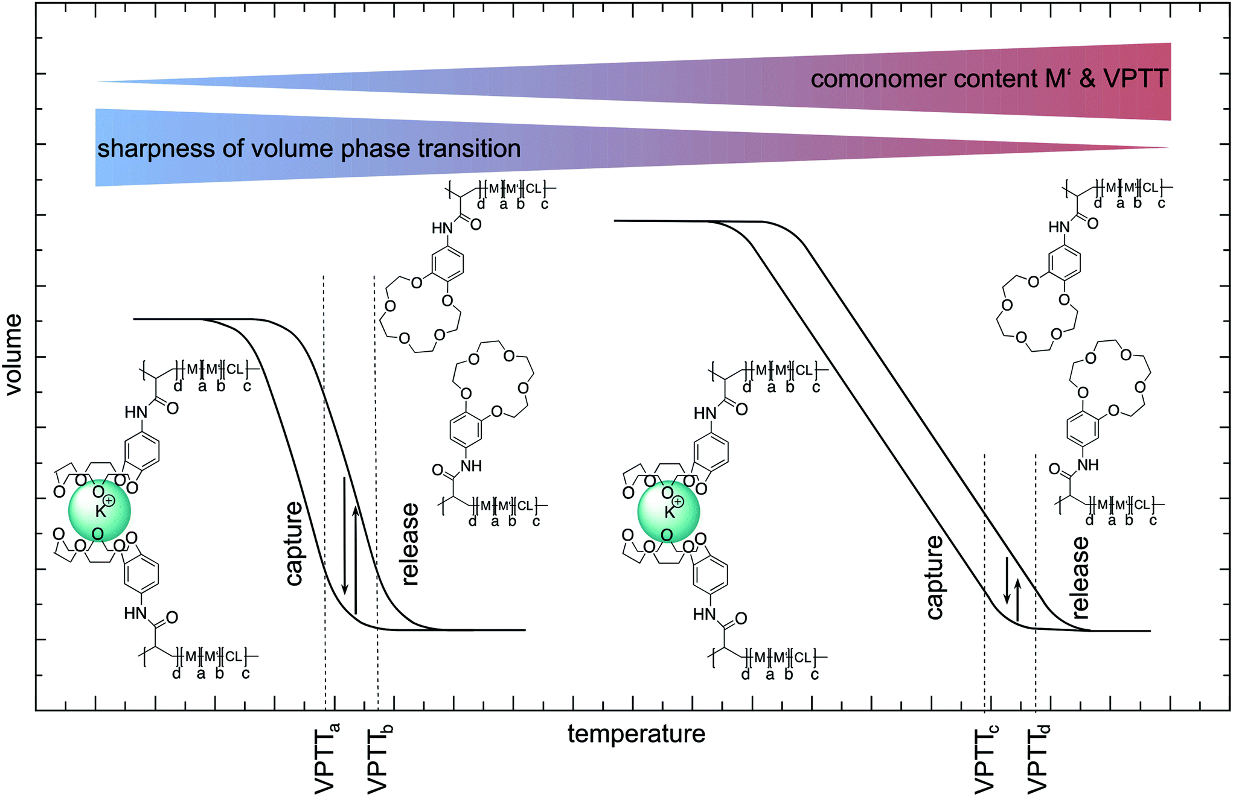
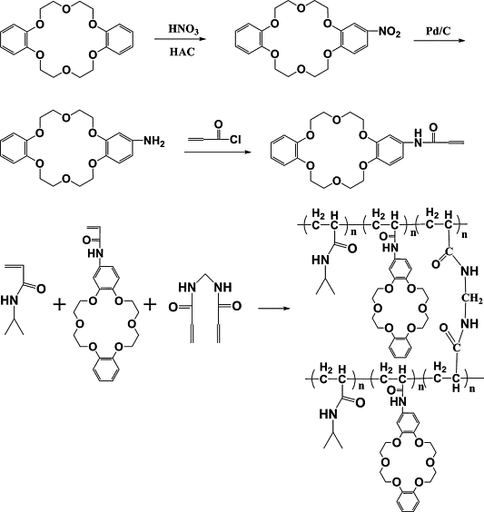
Smart Hydrogels – Salt- or ionic strenght-responsive
Important feature of hydrogels, considered that some biological processes such as nerve excitation, muscle contraction and cell locomotion involve ionic strength modification
Generally, the mechanism of the ionic strength-responsive polymers is that the added salt will reduce the electrostatic interactions between copolymers or between polymers and other molecules
Some weak PAAs and MAAs show an increased degree of ionization upon addition of lithium methoxide salt
Hydrogels composed PNIPAM exhibit LCST; its behavior showed also a sharp volume phase transition depending on the NaCl concentration
A PNIPAM hydrogel with specific sensitivity was synthetized by introducing di-benzo-18-crown-6 comonomers into the network
Notes:
This feature can be extremely important because some biological processes, such as nerve excitation, muscle contraction, and cell locomotion, involve ionic strength modifications. However, these polymers are less abundant than pH or temperature responsive and they have not been widely explored in drug delivery. Based on different salt concentration, some polymers undergo structural changes, which makes them ionic strength or salt responsive systems.
Similar to the previously described classes of pH responsive polymers, this proposed mechanism of responsiveness is based on increased hydrophobicity interactions promoted by salt concentration which result in a reduction of electrostatic repulsion between the copolymers, enabling network precipitation. Although sodium phosphate or sodium sulfate buffers promote a gradual reduction of hydrogel swelling, this behavior is not associated with phase transition.
Some weaks polyacids such as poly(acrylic acid) and methacrylic acid show an increased degree of ionization upon addition of lithium methoxide salt, which promotes viscosity changes. The shrinkage of coils is explained by the attraction between the mobile osmotically ion pairs.
Hydrogels composed of N-isopropylacrylamide (NIPAAm), a non ionic polymer, exhibit LCST transition. A group demonstrated that the NIPAAM polymer also showed a sharp volume phase transition depending on the sodium chloride concentration in the surrounding medium.
A PNIPAM hydrogel with specific sensitivity was synthetized by introducin di-benzo-18-crown-6 comonomers into the network. The developed system exhibited thermal responsivity and a swelling ratio sensitive to the presence of K+.

Slide 14
Smart Hydrogels – Bio-responsive
Changes might occur in response to increased concentration of specific biomolecule availability
Antibodies, T cells and enzymes are important biomolecules which can be used as important signals for disease diagnosis
Many research groups have focused in the development of smart self-regulated biomaterial systems, useful for drug delivery as well as for diagnosis, cell cultures, biosensors or matrices for tissue engineering and regenerative medicine
Three types of responsiveness
Glucose
Enzyme
Antigen
Glucose-repsonsive are widely used in diabetes treatment with different strategies for insulin self-regulation
Glucose oxidase (GOX)
Lecitin (concanvalin A)
Phenylboronic acid
Notes:
Bioresponsive hydrogels, also called biologically stimulated or biomolecule responsive hydrogels, are biomaterials able to undergo structural modifications (swelling/deswelling, degradation or erosion and mechanical deformation) mediated by biological reactions. Changes might occur in response to increased concentration of specific biomolecule availability (proteins, enzymes, peptides, antibodies) in physiological environment or under pathological conditions.
Antibodies and T cells are important biomolecules responsible for maintaining the normal body functions by controlling immune responses and autoimmunity, extremely affected in diseases such as cancer
Many research groups have recently focused in the development of bioresponsiveness hydrogels as smart-regulated biomaterial systems, useful not only for drug delivery but also for diagnosis, cell cultures, biosensors or matrices for tissue engineering and regenerative medicine.
Bioresponsive hydrogels can be classified according to their behavior and most of them exhibit three types of responsiveness.
The first, is related to glucose-responsive hydrogels designed with entrapped insulin, which selectively bind glucose molecules, triggering a response according to blood glucose levels.
The second type, enzyme responsive hydrogels, contain enzyme-sensitive substrate, such as short peptides, which can be programmed to respond to a specific enzyme. This concept is especially attractive since enzymes distribution occurs differently in different body parts and, primarly, in health and diseased environments.
The third class is represented by antigen responsive hydrogels, which exhibit antigens incorporated into their structural networks to recognize specific antibodies.
Glucose responsive hydrogels are widely used in the treatment of diabet, compensating for the inability of the pancreas to control glucose levels in the blood. Furthermore, these systems can exhibit different strategies for insulin self-regulation: those that use glucose oxidase, lectin and phenylboronic acid.

Slide 15
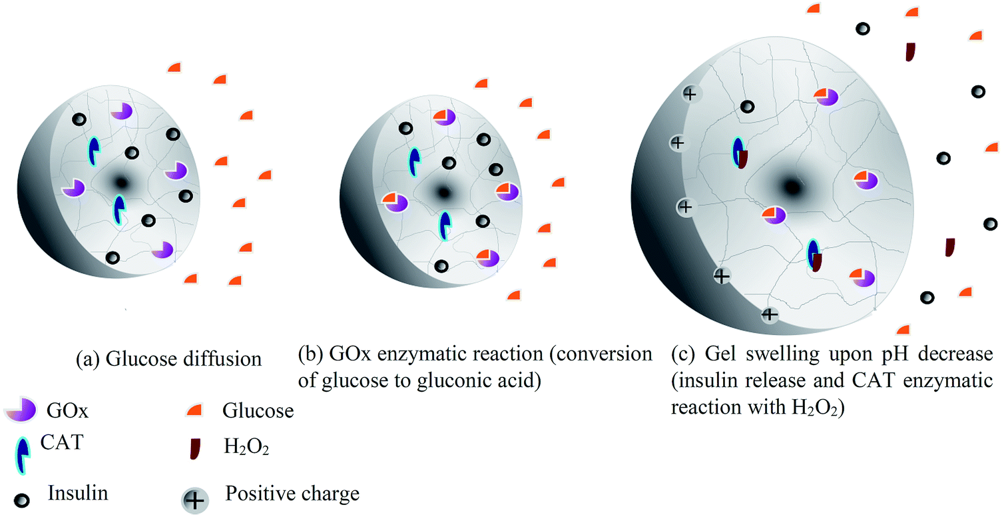
Smart Hydrogels – Glucose-responsive
Changes might occur in response to increased concentration of specific biomolecule availability
Antibodies, T cells and enzymes are important biomolecules which can be used as important signals for disease diagnosis
Many research groups have focused in the development of smart self-regulated biomaterial systems, useful for drug delivery as well as for diagnosis, cell cultures, biosensors or matrices for tissue engineering and regenerative medicine
Three types of responsiveness
Glucose
Enzyme
Antigen
Glucose-repsonsive are widely used in diabet treatment with different strategies for insulin self-regulation
Glucose oxidase (GOX)
Lecitin (concanvalin A)
Phenylboronic acid
Notes:
Glucose responsive hydrogels designed with the glucose oxidase enzyme (GOX), entrapped along the polymer chain, show a mechanism of responsiveness to pH changes in the environment. This occurs due to the cleavage of glucose molecules, followed by swelling/shrinking according to glucose level. Essentially, when glucose concentration increases in the blood, GOX converts glucose in glucuronic acid and H2O2, which lowers the pH inside the hydrogel. This reduction increases ionization of functional groups and polymer chain repulsion inside the network, leading to hydrogel swelling and insulin permeation throughout the network reaching the blood.

Slide 16
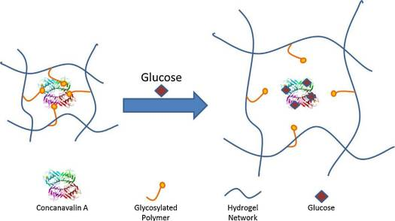
Smart Hydrogels – Glucose-responsive
Changes might occur in response to increased concentration of specific biomolecule availability
Antibodies, T cells and enzymes are important biomolecules which can be used as important signals for disease diagnosis
Many research groups have focused in the development of smart self-regulated biomaterial systems, useful for drug delivery as well as for diagnosis, cell cultures, biosensors or matrices for tissue engineering and regenerative medicine
Three types of responsiveness
Glucose
Enzyme
Antigen
Glucose-repsonsive are widely used in diabet treatment with different strategies for insulin self-regulation
Glucose oxidase (GOX)
Lecitin (concanvalin A)
Phenylboronic acid
Notes:
The second main pathway for glucose responsiveness consist of incorporating lecitins, such as concanavalin A, into hydrogels. Lecitins are carbohydrate-binding proteins able to form complexes with glycoproteins and glycolipids present on the cell surface. Glucose responsive systems designed with entrapped Con A are able to control the release of glycosylated insulin by lecitin-binding in response to free glucose. These systems show the competitive binding behavior of con A with glucose and glycosylated insulin, since con A has a higher affinity for glucose than the glycosylated moieties. Therefore, expansion of the polymer chains lead to swelling and, consequently, insulin release by diffusion.

Slide 17
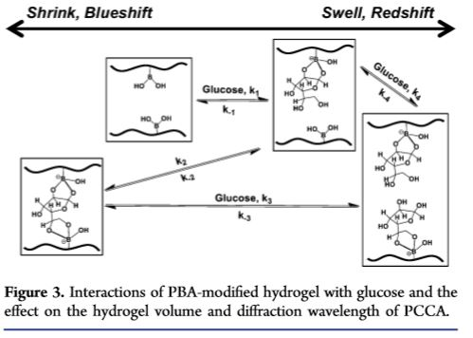
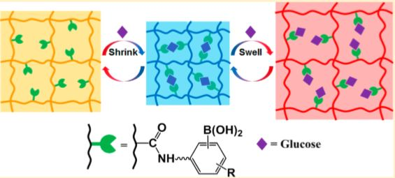
Smart Hydrogels – Glucose-responsive
Changes might occur in response to increased concentration of specific biomolecule availability
Antibodies, T cells and enzymes are important biomolecules which can be used as important signals for disease diagnosis
Many research groups have focused in the development of smart self-regulated biomaterial systems, useful for drug delivery as well as for diagnosis, cell cultures, biosensors or matrices for tissue engineering and regenerative medicine
Three types of responsiveness
Glucose
Enzyme
Antigen
Glucose-repsonsive are widely used in diabet treatment with different strategies for insulin self-regulation
Glucose oxidase (GOX)
Lecitin (concanvalin A)
Phenylboronic acid (PBA)
Notes:
The last main mechanism of glucose responsive hydrogels is based on phenylboronic acid (PBA). The ability of PBA to sense glucose and to release insulin in a controlled manner is due to their affinity for polyol molecules (sugar alcohols). After recognizing glucose molecules, PBA is reversibly complexed with polyol compounds. The interaction between immobilized PBA and glucose leads to volumetric changes, which allow insulin release. In aqueous environments, phenylborate groups exhibit an equilibrium between uncharged and charged forms. The reaction between PBA and glucose occurs through the cationic charged form and therefore the reaction shifts the overall gel charge density toward cationic charged species as a consequence of the dissociation equilibrium. Glucose is represented as glucofuranose in this picture, means in the 5membered ring. The increased charge into the hydrogel promotes polymer chains repulsion and increase hydrophilicity, leading to swelling.

Slide 18
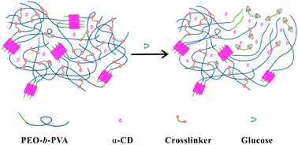
Smart Hydrogels – Glucose-responsive
Changes might occur in response to increased concentration of specific biomolecule availability
Antibodies, T cells and enzymes are important biomolecules which can be used as important signals for disease diagnosis
Many research groups have focused in the development of smart self-regulated biomaterial systems, useful for drug delivery as well as for diagnosis, cell cultures, biosensors or matrices for tissue engineering and regenerative medicine
Three types of responsiveness
Glucose
Enzyme
Antigen
Glucose-repsonsive are widely used in diabet treatment with different strategies for insulin self-regulation
Novel glucose-responsive system based on covalent dynamic bonds
Notes:
A novel glucose responsive system based on covalent dynamic bonds and inclusion complexation was developed using the polyethylene oxide b poly vinyl alcol (PEO-b-PVA) deblock polymer, a-cyclodextrine (a-CD) and phenylboronic acid (PBA)-terminated PEO cross-linker.

Slide 19
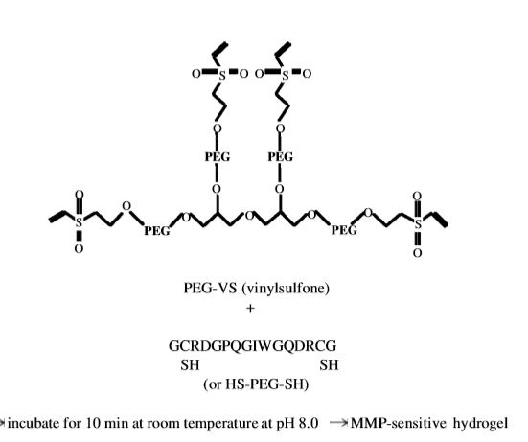
Smart Hydrogels – Enzyme-responsive
In cellular environment, most stimuli-responsive mechanisms are under control of enzymes
Since enzymes are highly selective in their reactivity, responsiveness is specific
First application related to tissue engineering for cartilage repair and chondrocyte culture
Enzyme-repsonsive are also widely exploited to release drugs specifically in the colon
Biodegradable polymers include naturally derived polymers such as pectin, amylose, gelan gum, chitosan, alginate and dextran
Artificial non-biodegradable polymers include PEG, PEO, pHEMA, PNIPA
Antigen-responsive hydrogels are able to undergo volume or structural changes in the presence of antibodies
Notes:
In cellular environment, most stimuli-responsive mechanisms are under control of enzymes. These systems can be designed based on peptidic building blocks, such as short sequences of aminoacids, specifically degradated or digested by certain enzymes, which result in hydrogel degradation. Since enzymes are highly selective in their reactivity, responsiveness is specific.
The first reported application related to tissue engineering was a metalloproteinase (MMP) sensitive PEG-based hydrogel developed for cartilage repair and chondrocyte culture. MMP-sensitive peptides were used as hydrogel cross-linkers, yielding a material that was specifically degradated by gelatinase and collagenase.
Enzyme-repsonsive are also widely used to release drugs specifically in the colon. The use of pH sensitive monomers cross-linked with azo-aromatic bonds allows the degradability of the system to be restricted to the colon environment. When the system arrives in the colon, the hydrogels reach their highest swelling degree. The cross-linked bonds are degradated by the action of azo-reductase enzymes or mediators. Subsequently, the hydrogel network can be degraded by cross-link cleavage, and the drug can be released at the desired site.
Biodegradable polymers…
Non biodegradable polymers; polyehtylene glycole, polyethylene oxide, polyhydroxyethyl metacrylate and poly isopropylamide
Antibodies are biomolecule able to recognize specific antigens and to establish contact through supramolecular interactions. Thus, antigen responsive hydrogels are able to undergo volume or structural changes in the presence of antibodies.

Slide 20
Smart Hydrogels – Functional delivery systems
The application of these bioactuating systems requires a sophisticated molecular design, which increases their potential application
Some disease are known for significant changes on the homeostasis state
Pathological aspects that can be explored toward this objective
Inflammatory processes
Cancer therapy
Diabetes mellitus
Which applications of smart polymers will likely succeed in clinic and why?
Tissue Engineering
Harder to simulate bodily environment for tests
Also, difficult to assess performance of grafts/ scaffolds/other devices in vivo
May be developed for longer-term applications, so in turn it will take longer to test the materials
Depends on whether you want to implant polymer scaffold with cells or wait for scaffold to degrade before implantation
Drug delivery
Short-term operation, so it may take less time to complete testing
Simple methods available to study release in vitro and able to test drug concentration for in vivo tests
Smart diagnostic applications
Testing material, if not in body the regulations are much easier to meet/test
Notes:
Smart hydrogels in nature can represent a model system for studying dynamic interactions between cells, between cells and extracellular matrix, and between drug delivery and biological systems, as all these interactions can be of dynamic nature. However, the application of these bioactuating systems requires a sophisticated molecular design, which increases their potential application
Some diseases are known for significant changes on the homeostasis state. In this sense, a smart system can be initially designed from target pathology characteristics. Here, we highlight some pathological aspects that can be explored toward this objective.
Regarding inflammatory processes, pH and thermo responsive polymers are the most promising ones while for cancer treatment pH, thermo and MMP which are zinc dependent enzymes. For diabete, glucose responsive
Future perspectives: Science is constantly in expansion and fundamentally, the introduction of new technologies creates challenges for those responsible for regulating aspects applied on these new products, particularly if they may cause risks to health and environment. The absence of a homogeneous and clear regulatory guidelines involving technology-based smart systems creates an unstable scenario where benefits can be confused with risks, hindering their clinical outcome.
However, while many scientific reports have been published, a low number of hydrogel products are currently being used in clinical trials. This time lapse reflects the need for optimized designs of advanced smart systems, that focus on important aspects of human diseases and therapy efficacy along with toxicity predictions and regulatory improvements.
Researchers believe that the use of dynamic hydrogels as drug delivery systems is still in its initial stage.
Which applications of smart polymers will likely succeed in clinical and why? It greatly depends on the application:

